Slide 1



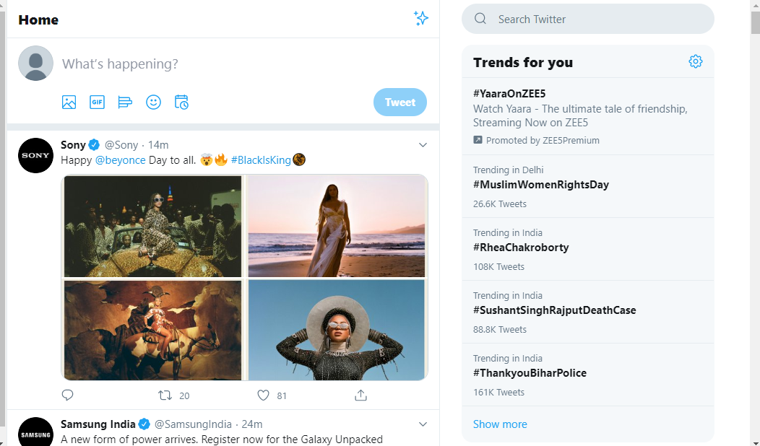


Extreme User Detection
On TWITTER
By:-
TEAM 6
Mentors:
Mr. Rishabh
Ms. Neha

Slide 2
Problem Statement
To classify the users as extreme users on social media platform (Twitter) on the basis of average time difference between their tweets
Extreme Users (EU): Users who post frequently on a particular topic, i.e. in less than 90 minutes on political aspects (in our case).

Slide 3
Motivation
To nudge the user on extreme involvement on a topic
To identify politically active users
To identify users contributing in political aspect
To allow various bodies to understand emotions and reactions of people, here government bodies.

Slide 4
Related Work
Research papers read:
Extreme User and Political Rumor and Detection on Twitter
Presentation link
Social Network of Extreme Tweeters: A Case Study
Presentation link
Identifying and Analyzing Researchers on Twitter
Presentation link

Slide 5
Steps Timeline:
Data Collection
Data Filtering
Average time Difference
5 most retweeted tweets
Outlier Detection
Data Analysis
Table Preprocessing
Sentiment Analysis

Slide 6
Data Collection
Twitter API keys
Script for continuous data collection
Query creation
Run script to collect data

Slide 7
Data Filtering
Unique tweets identification
Unique users identification
Removal of records of users having less than 3 tweets
Grouping of data on the basis of user id and tweet id
Calculation of average time difference between tweets of each user (in hours, mins)

Slide 8
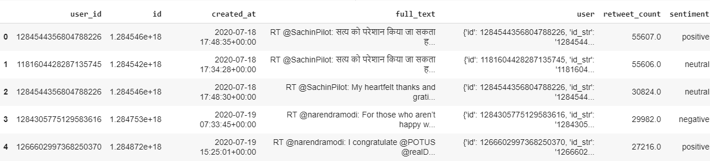
5 Most Retweeted Tweets

Slide 9
Statistics
Tweets collected (with duplicates) | 1,025,937
Tweets (without duplicates) | 137,409
Tweets used (more than 2 tweets by the user) | 70,334
Queries used | 24
Average time difference of all users (in minutes) | 292.61
Average followers count of all users | 3.092492e+03
Average retweet count of all users | 639.97

Slide 10




Sentiment Analysis
Cleaning of tweet text using regular expression to remove ‘@, https://,#’,etc
Translation of tweet texts of other languages to English for sentiment analysis.
Analysis of tweet text.
RESULT (out of 70,334 tweets):
Positive = 44.6 %
Neutral = 34.8 %
Negative = 20.6 %

Slide 11
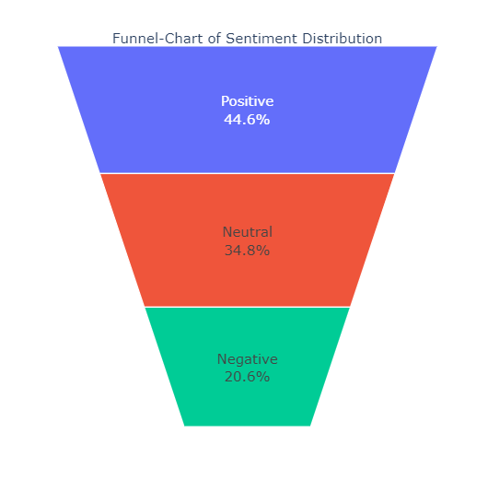
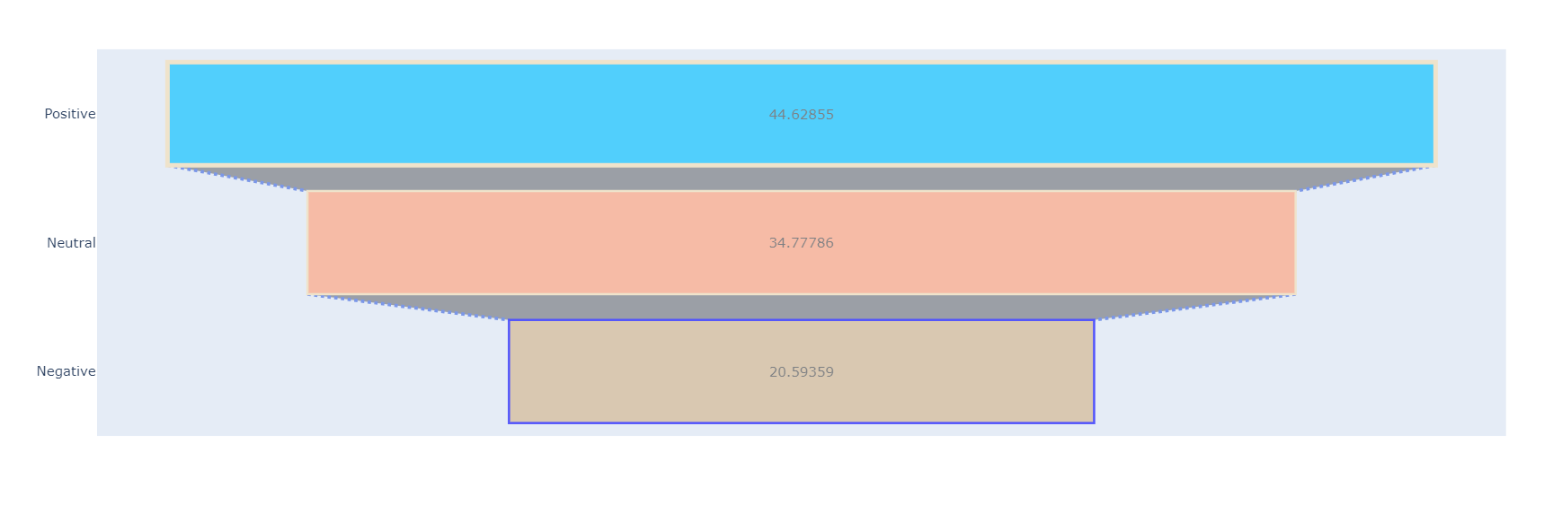

Slide 12
Table Preprocessing
Calculated max followers count of each user
Calculated max retweet count of each user
Addition of sentiment and sentiment score of each tweet as per words used in it (positive, negative, neutral)
Removal of unnecessary columns and addition of new required columns

Slide 13
Table Created
Before table processing: 34 columns
After table processing: 9 columns
Having features defined by us, such as:
Average time difference (in hours and mins)
Sentiment and Sentiment score
Extreme user classification

Slide 14
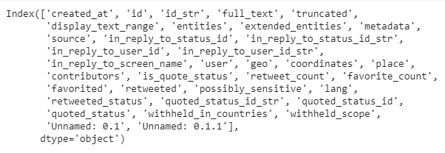
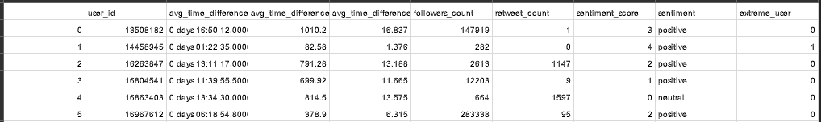
Before:
After:

Slide 15
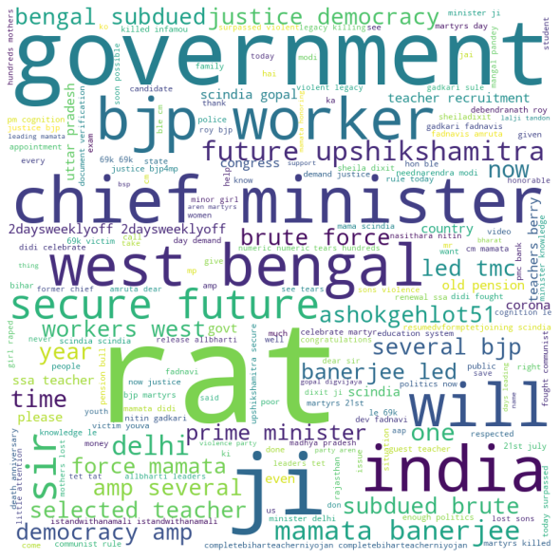
Word Cloud

Slide 16


Data Analysis
(EDA)
Graph plotting on the data collected
Multiple graphs plotting using different parameters

Slide 17
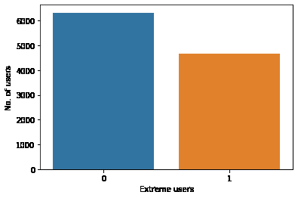

Slide 18
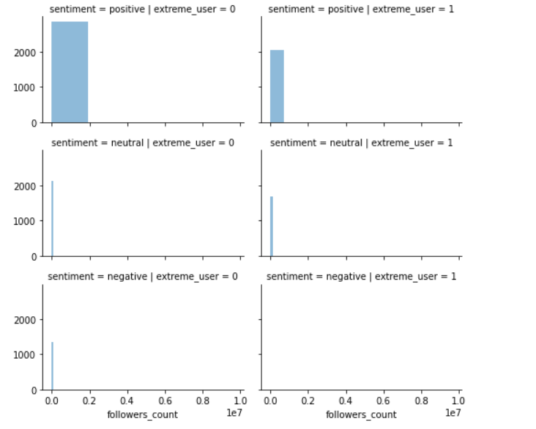
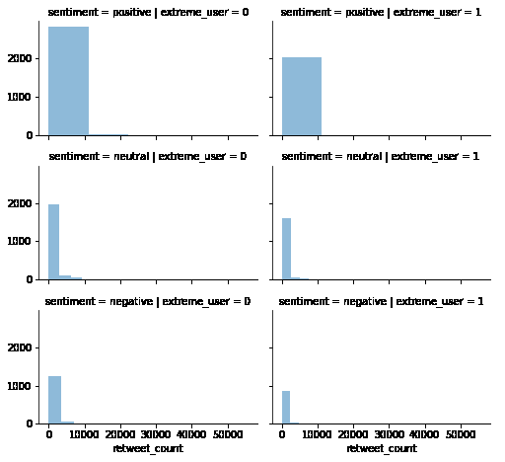

Slide 19
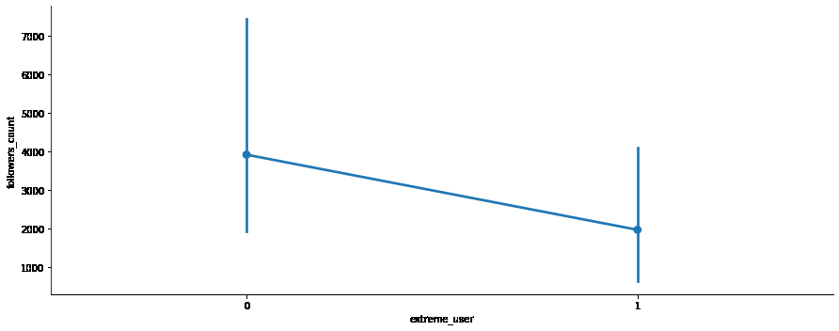
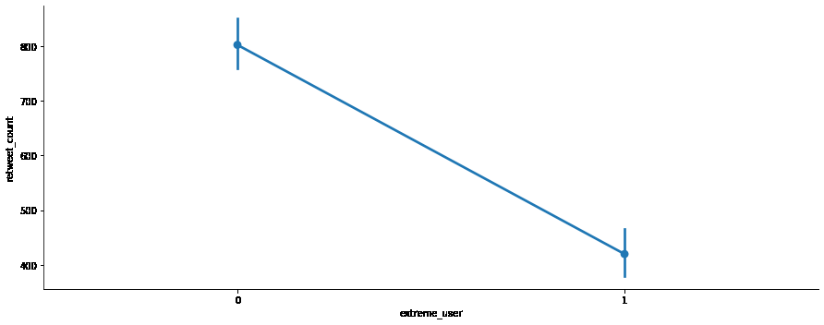

Slide 20
Algorithms Applied to Data
K - Means
Logistic Regression
Decision Trees

Slide 21
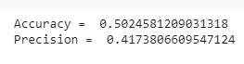
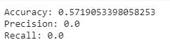
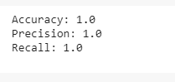
K - Means
Logistic Regression
Decision Trees

Slide 22
State your assumptions or any unknowns here.
Outlier Detection
Detection of missing values from our dataset
Outliers detection of dataset
Algorithms used in the detection of outliers
Algorithm | Accuracy
Angle-Based Outlier Detection (ABOD) | 0.43200550721
K-Nearest Neighbors (KNN) | 0.35416783572
Isolation Forest | 0.5308630732

Slide 23
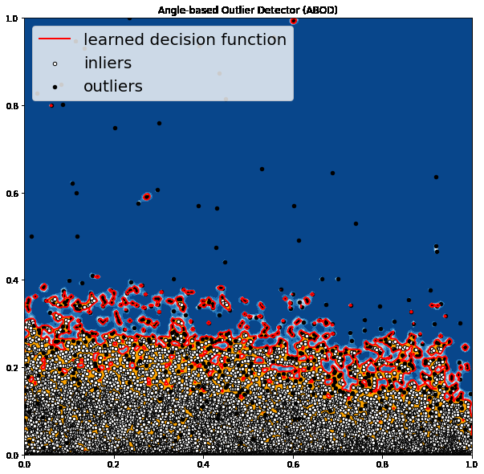
X,Y = 659, 10325

Slide 24
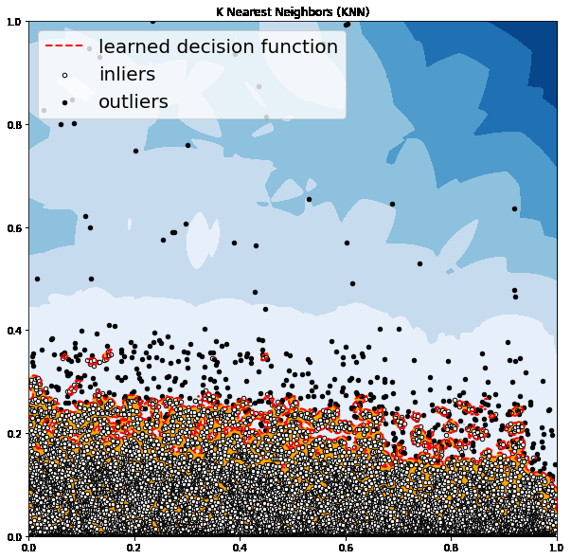
X,Y = 498, 10486

Slide 25
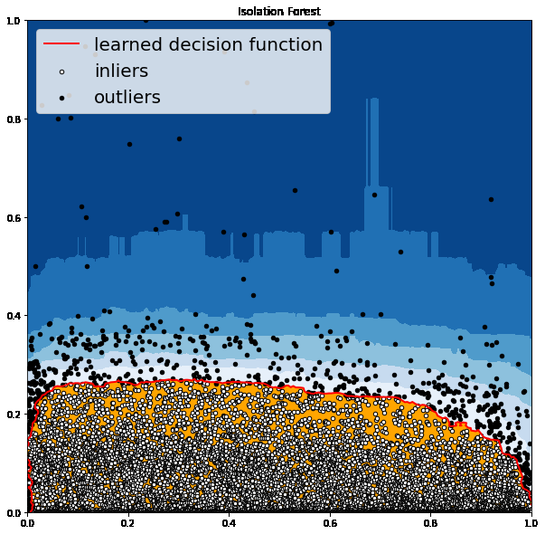
X,Y = 659, 10325

Slide 26
Future Scope
Optimise scripts.
Identify more features to classify users as extreme users.
Expand topic range.
Add more sentiments in sentiment analysis, such as ‘Sarcasm’, ‘Irony’, etc.
Add feature on Twitter to nudge the user on extreme involvement on a topic.

Slide 27
Students in team
Bhanupriya Sharma (IGDTUW), 3rd sem, B.Tech. MAE
Vibhuti Srivastava (IGDTUW), 3rd sem, B.Tech. MAE
Tanya Goel (MAIT, GGSIPU), 5th sem, B.Tech. CSE
Shriyanshi Jha (IGDTUW), 3rd sem, M.Tech. IT
Juhi Gulati (IGDTUW), 3rd sem, M.Tech. IT
Kritika Verma (IGDTUW), 3rd sem, M.Tech. IT

Slide 28
Questions?
Thank you
With regards
TEAM 6

